Slide 1
Leveraging Conceptual Lexicon：Query Disambiguation using Proximity Information for Patent Retrieval
Date : 2013/10/30
Author : Parvaz Mahdabi, Shima Gerani,
Jimmy Xiangji Huang and Fabio Crestani
Source : SIGIR’13
Advisor : Jia-ling Koh
Speaker : Yi-hsuan Yeh

Slide 2
Outline
Introduction
Method
Experiments
Conclusion

Slide 3
Introduction
Patent prior art search is a task in patent retrieval where the goal is to rank documents which describe prior art work related to a patent application.
Challenge：
Find a focused information need and remove the ambiguous and noisy terms.
Query disambiguation. (ex：bus)

Slide 4
Introduction
Previous work has not fully studied the effect of using proximity information and exploiting domain specific resources for performing query disambiguation.
Terms closer to query terms are more likely to be related to the query topic.
Using a domain dependent resource leads to the extraction of more relevant expansion concepts.
Propose a proximity based framework for query expansion which utilizes a conceptual lexicon for patent retrieval.

Slide 5
Framework
Query
patent document
Query
Re-rank result list
Proximity-based method
Query expansion
terms
Query-specific lexicon

Slide 6
Outline
Introduction
Method
Query document reduction
Building conceptual lexicon
Proximity-based framework
Document relevance score
Expansion concept selection strategies
Experiments
Conclusion

Slide 7
Query document reduction
Query patent：title, abstract, description, and claims
Example：
A chair having only two legs.
The chair of claim $1$, further comprising at least one leg made of wood.
Claim $1$ is independent because it does not reference any other claim.
Use the items in the first independent claim as the initial query.
Notes:
記載申請專利發明之構成之技術內容、特點 http://www.bpmlegal.com/howtopat5.html

Slide 8
Building conceptual lexicon
Form：IPC (International Patent Classification) definition pages
Stop-words removal
Filter out document frequency > 10
The IPC class of the query is searched in the lexicon and the terms matching this class are considered as candidate expansion terms.
Candidate expansion terms

Slide 9
Proximity-based framework
Assume：An expansion term refer with higher probability to the query terms closer to its position.
Position
An expansion term($i=12$)
1
12
Query term ($j=32$)
20
Document d
32
$$i：12$$
$$j：1, 20, 32$$
$t_{j}$：the query term at position $j$ in the document d

Slide 10
$P\left(q|t_{j}\right)$
Term $t_{j}$
$$d_{2}$$
$$d_{1}$$
Query：$\left\{chair, leg\right\}$
Term $t_{j}$：chair
$$d_{3}$$
$$d_{4}$$
$$p\left(q|t_{j}\right)=\frac{2}{5}$$
$$d_{5}$$
Query

Slide 11
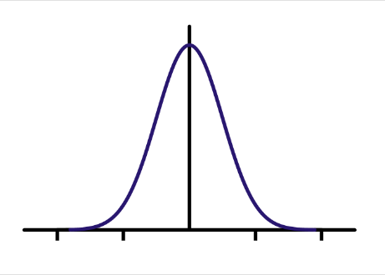
$P\left(j|i,d\right)$
Gaussian kernel
Laplace kernel
Rectangle kernel
$$k\left(j,i\right)$$
$$i$$
$$j$$

Slide 12
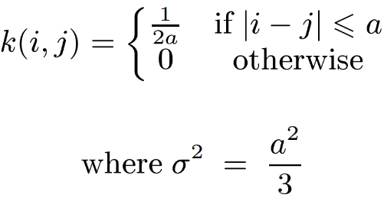
Example：
Rectangle kernel
𝜎：bandwidth parameter
Assume：$σ=2$
$$⇒a=\sqrt{12}=2\sqrt{3}≒3.46$$
$$⇒\frac{1}{2a}=\frac{1}{4\sqrt{3}}≒0.144$$
$$k\left(i,j\right)$$
Bandwidth = 2
$$0.144$$
$$i+2$$
$$position$$
$$i−3$$
$$i−2$$
$$i−1$$
$$i+1$$
$$i+3$$
$$i$$

Slide 13
Document relevance score
Avg position strategy
Max position strategy
$e :$ expansion term
Documents
$$t_{1}$$
$$t_{2}$$
$$t_{3}$$

Slide 14
Expansion concept selection strategies
Explicit expansion concepts (EEC)
Restrict expansion term that appear in $D_{Q}$(query document).
Implicit expansion concepts (IEC)
Use all expansion term.

Slide 15
Combine search strategies (CSS)
Linear combine query result lists and IPC expansion concepts result list.
Proximity-based pseudo relevance feedback (PPRF)
Extracting expansion concepts form the feedback documents.

Slide 16
Outline
Introduction
Method
Experiments
Conclusion

Slide 17
Experiments
Dataset：
CLEF-IP 2010, CLEF-IP 2011
Evaluation：
Top 1000 results
MAP, Recall and PRES(patent retrieval evaluation score)
Baseline：
Language modeling with Dirichlet smoothing
+ language model re-rank

Slide 18
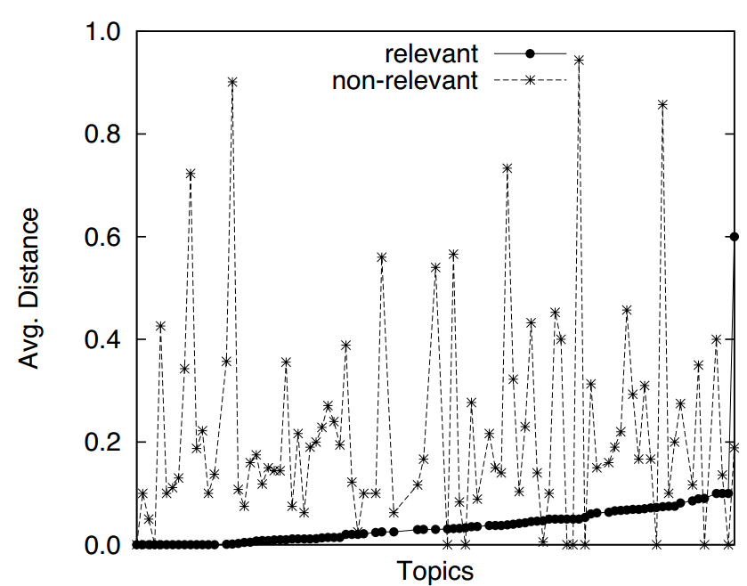
Motivation for Using Proximity Information
CLEF-IP 2010
100 random queries, top 100 documents

Slide 19
Effect of Density Kernel

Slide 20
Comparison of Max and Avg Strategy
CLEF-IP 2010
Gaussian kernel
IEC

Slide 21
Number of Expansion Terms

Slide 22
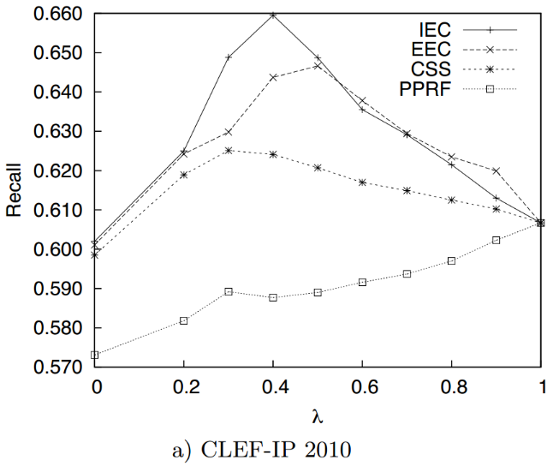
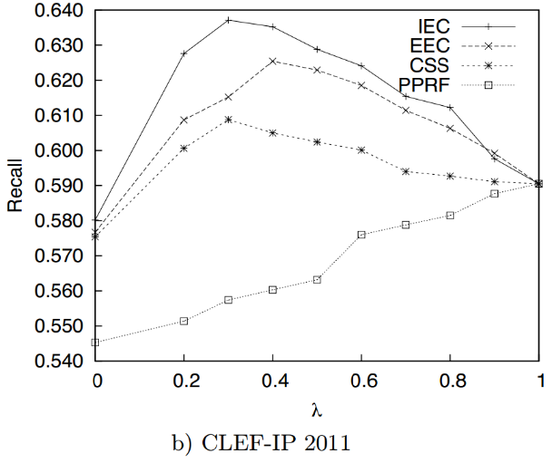
Effect of Combination
λ=0：the query expansion model is used
λ=1：the initial query is used.

Slide 23
Effect of Query Reformulation
Gaussian kernel
Max strategy
40 expansion terms
$λ=0.4$

Slide 24
Outline
Introduction
Method
Experiments
Conclusion

Slide 25
Conclusion
Constructed a domain dependent conceptual lexicon which can be used as an external resource for query expansion.
Proximity-based retrieval framework provides a principled way to calculate the importance weight for expansion terms selected from the conceptual lexicon.
We showed that proximity of expansion terms to query terms is a good indicator of the importance of the expansion terms.

